Slide 1
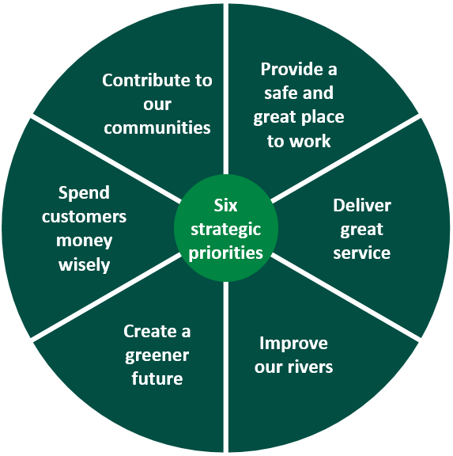



Learning At Work Week 2025 – 12th – 18th May
Helping you develop and grow your skills at UU
Feedback from our colleagues has told us that you want more career progression here at UU, and you want to grow your skills.
In support of this, we thought we’d promote and share with you some useful links, helpful resources and guidance as part of ‘Learning At Work Week – 2025’
This years theme is all about ‘Get Connected’. It highlights the social aspect of lifelong learning at work
Connect and grow – Lifelong learning offers many benefits. As well as developing our capabilities, understanding, values and ideas, it can increase our capacity to reflect, and promote health and happiness. Our motivation to learn can be increased if we expect that the learning we take up will help us reach our work and personal goals, and that we will be successful at it – something that is supported by having positive experiences of learning, confidence in our abilities as a learner and peer and community support.
Connect and inspire - Employees who are coaches, mentors, learning champions, managers and leaders have different roles at work, but they all have the power to inspire their colleagues to reflect and think about their learning journeys, goals and opportunities; and encourage them to participate in the learning on offer.
Connect and share - Connecting and learning with peers is a powerful way to explore and share a wide range of knowledge, ideas and resources across the organisation. It has many other benefits too ranging from community building and improved performance to shared understanding and meaningful relationships. It can help people feel valued, motivated and connected to the place where they work, nurturing a sense of belonging and wellbeing. Exchanging knowledge and ideas with colleagues in external organisations can provide insights that shape services and products, drive innovation and build collaborations; and foster critical knowledge transfer between colleagues and different generations.
Want to know more? Please visit ‘Learning At Work Week’ for more details and information
Learning At Work Week 2025
Some useful links to support your continual learning:
Helping you on your Career Journey at UU
educate
UU Lifelong Learning - Home
Leadership Development Store
Skills for life
Skills for careers
Open Learn
BBC Bitesize

